Slide 1
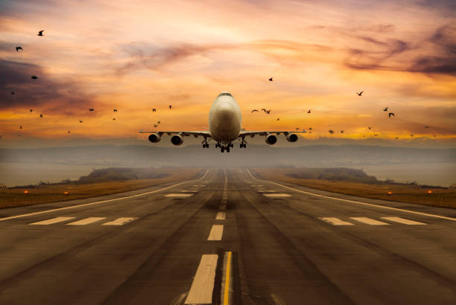
Data ANALYSIS of Bird Strikes between 2000 – 2011
Group Members Name : 1. Deepak Yadav 2. Karthikeyan 3. Vishal Suresh Kamdi 4. Jaya Tomar 5. Shipra Sultania 6. Ujwal Dupare
28.06.2023
DBI002
Group - 10

Slide 2
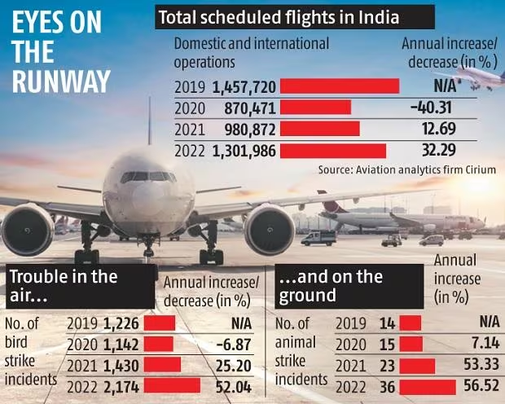
Why this problem is relevant?
Bird Strike: A collision between a bird and an aircraft.
Bird and animal strikes are not all that uncommon at Indian airports.
Bird and animal strike incidents are considered one of the most potent threats to flight operations in India.
The Indian airspace saw a 52% jump in bird strike incidents in 2022 as commercial aviation picked up significant pace after the pandemic. According to the Directorate General of Civil Aviation (DGCA), last year the country witnessed 2,174 aircraft bird strike incidents, up from 1,430 in 2021.
Not only bird hits, but animal strike incidents at airports also rose from 23 in 2021 to 36 in 2022, as per data reviewed by Business Standard from the DGCA.
Bird strikes may occur during any phase of flight, but are most likely during the take-off, initial climb, approach and landing phases due to the greater numbers of birds in flight at lower levels.
Prevention of the birds strikes, can not save only people and birds but also millions in dollars of damage to the aircraft.

Slide 3
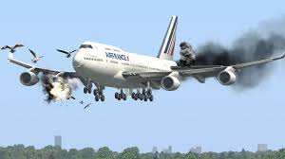
Incidents happened in India
Earlier this month, an AirAsia India flight heading to Pune had to do an emergency landing at the Bhubaneswar airport after being hit by a bird.
In June, a Boeing 737 operated by SpiceJet had to make an emergency landing shortly after take-off at Patna airport (PAT) due to a bird being ingested by one of its engines. Sparks were noticed coming from the left engine by both passengers and cabin crew.
On the same day, an IndiGo Airbus A320neo operating flight 6E-6394 from Guwahati (GAU) to New Delhi (DEL) also returned to its airport of origin. The aircraft’s number one engine was hit by a bird at an altitude of around 1,600 feet. The pilots declared PAN PAN and returned to Guwahati airport safely.
Prevention of the birds strikes, can not save only people and birds but also millions in dollars of damage to the aircraft.

Slide 4
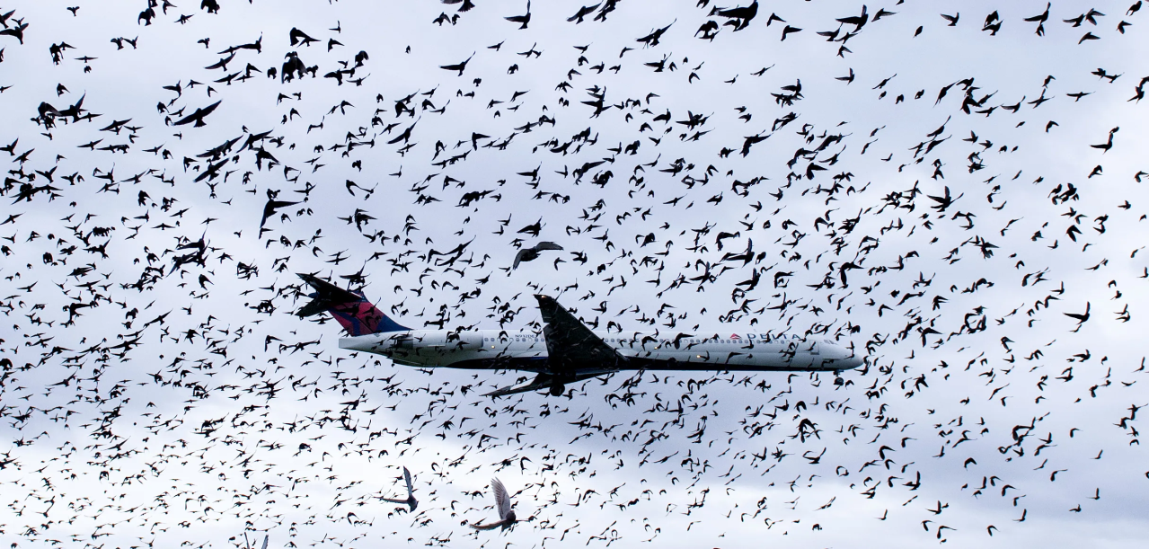
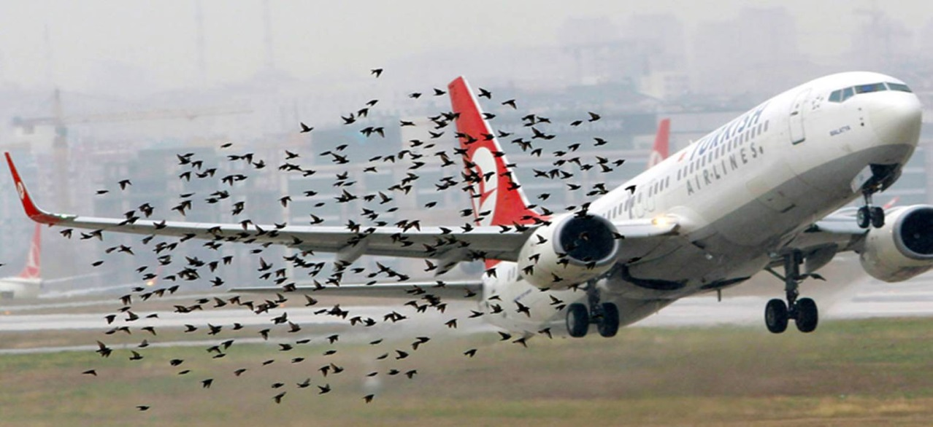
Problem Statement
Transport and communication are in the crucial domain in the field of analytics.
Environmental impacts and safety are, nowadays, two major concerns of the scientific community with respect to transport scenarios and to the ever-growing urban areas. These issues gain more importance due to the increasing amount of vehicles and people.
Seeking new solutions is reaching a point where available technologies and artificial intelligence, are being recognized as ways to cope with and tackle these kinds of problems in a distributed and more appropriate way.
To have a closer look the following document visually depicts the data collected on Bird Strikes between 2000-2011.

Slide 5
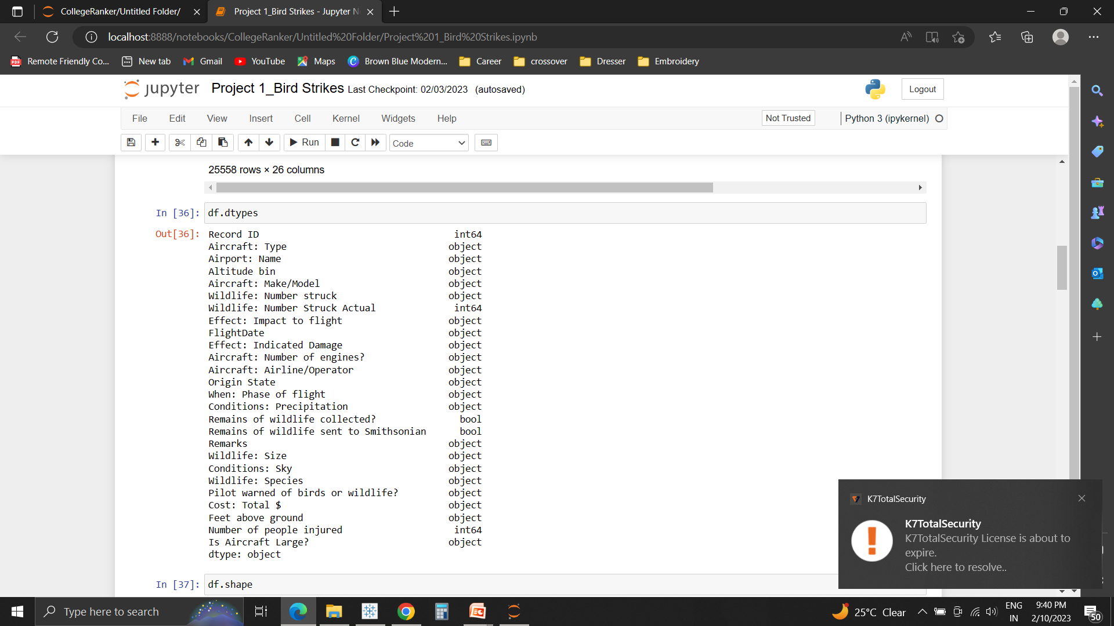


Descriptive Analysis
Our project visually depicts the data collected on Bird Strikes by Federal Aviation Administration (FAA) between 2000-2011.
Approach:
Python: Used for Data Cleaning
Power BI: For Visualization.
Based on the findings, a story is created.
For better understanding, the results are displayed on 3 dashboards of the story, listed as:
Direct/Indirect Impact on Mankind
Air Service and Environmental Conditions
Study on Birds
Attributes present in the data
Link to Python Notebook: https://colab.research.google.com/drive/1RCGSNC4JC5RiHvQtwuSX58iOUO3xiNec#scrollTo=944f0f1b

Slide 6
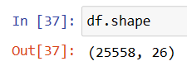
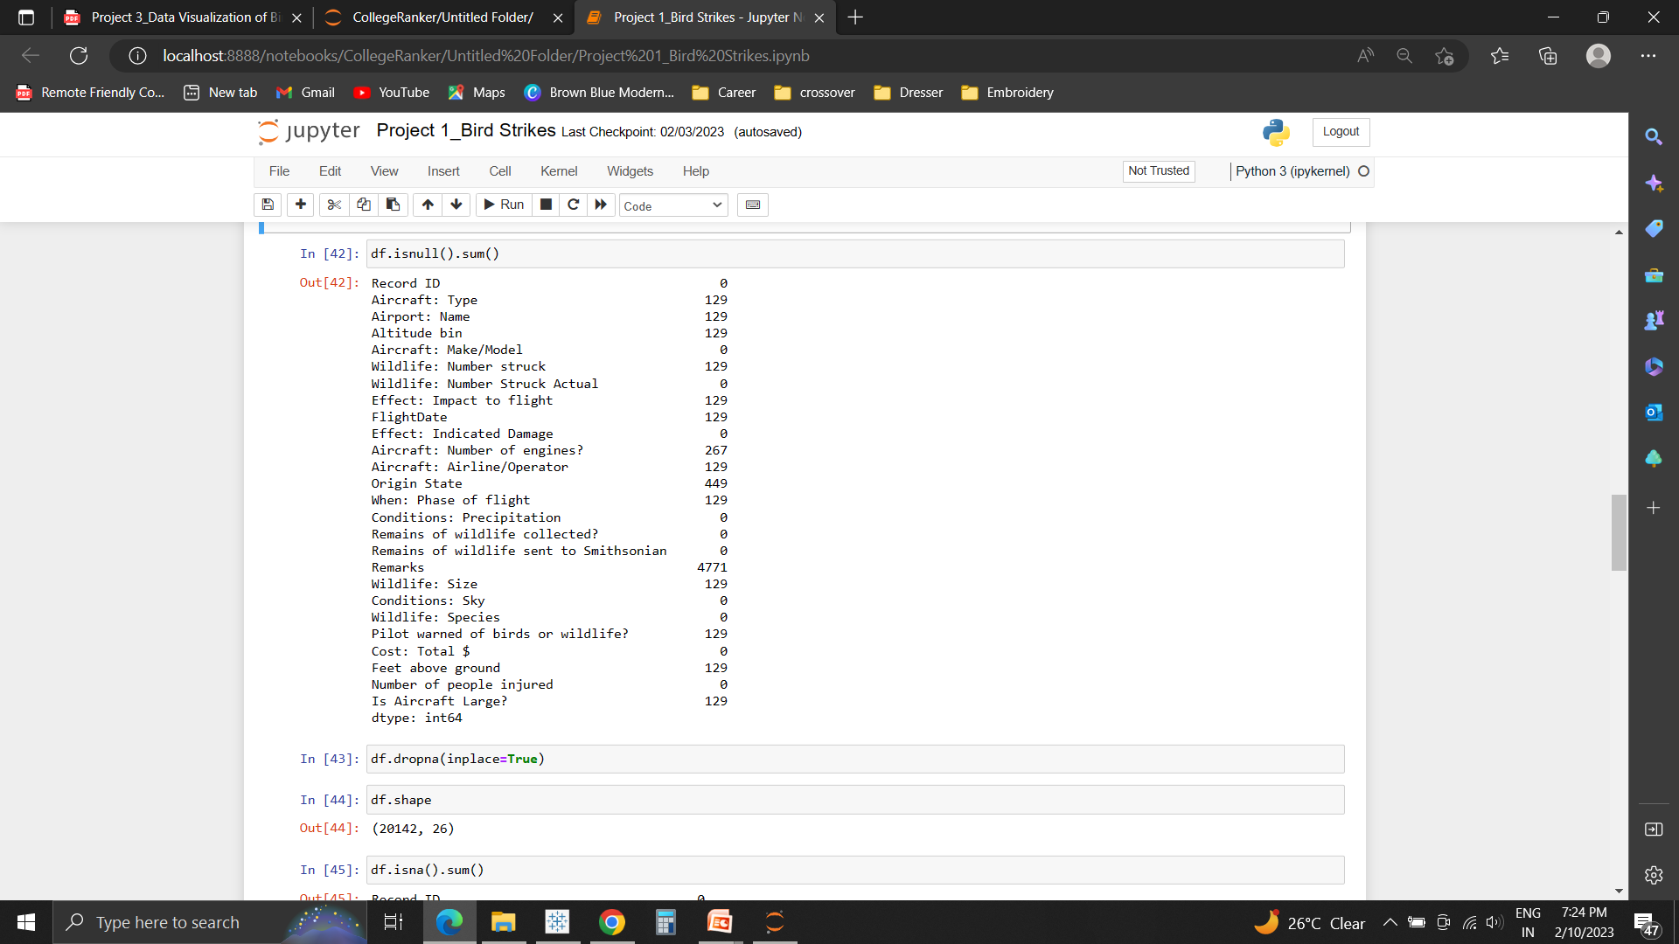
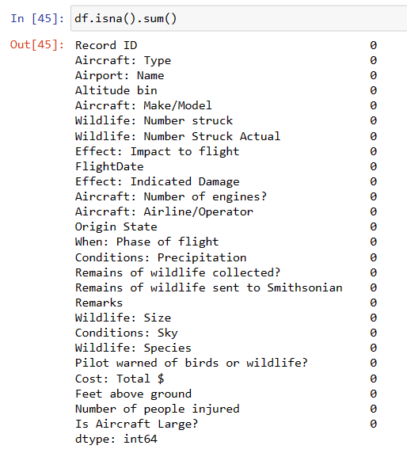
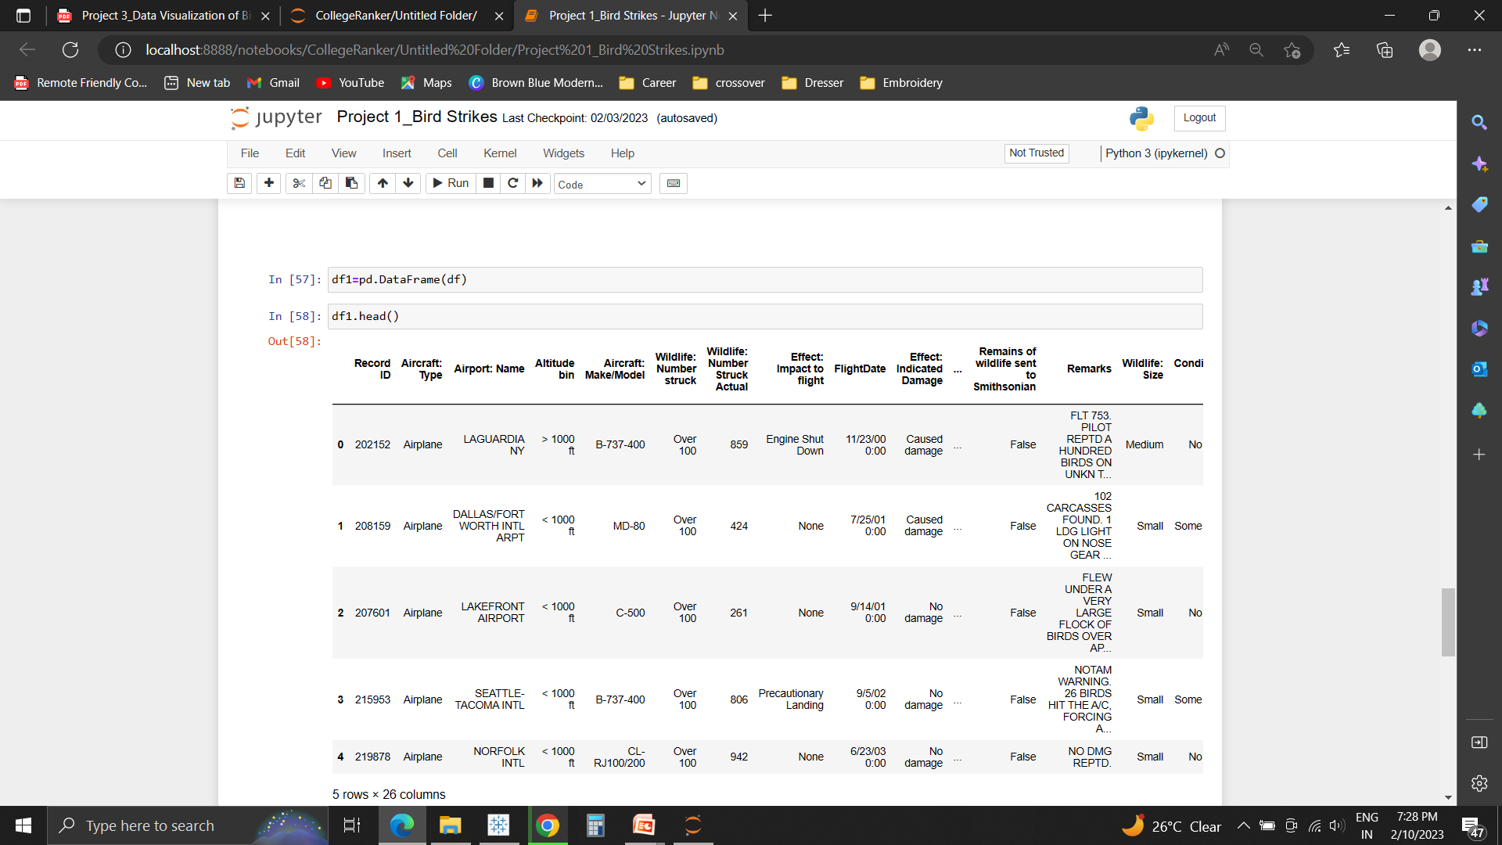
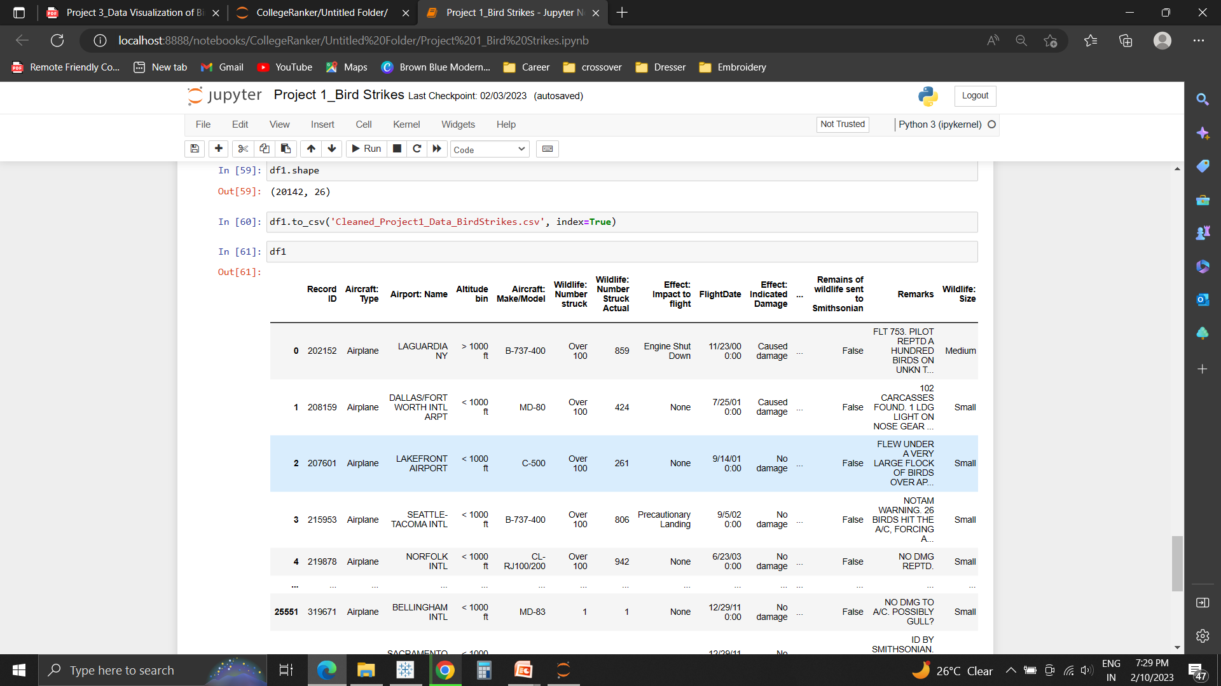
Data Cleaning
Dataset was first read.
Missing and null values were found and removed using dropna ( ) method. (5416 null values were removed, there were no duplicate values).
Cleaned file is downloaded for visual analysis in Power BI.

Slide 7
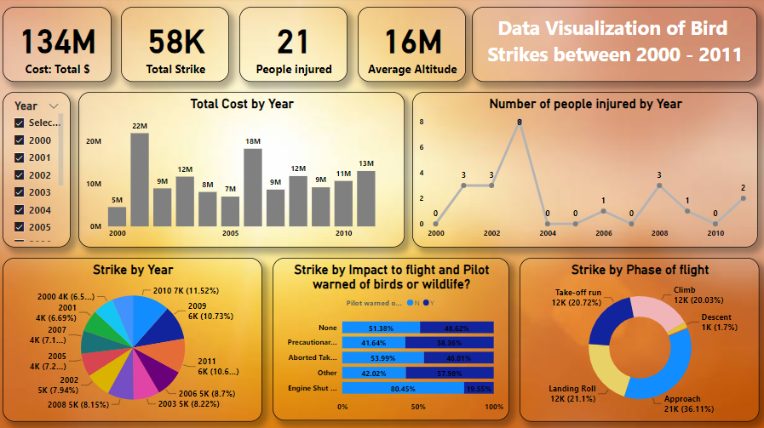
Direct/Indirect Impact on Mankind

Slide 8
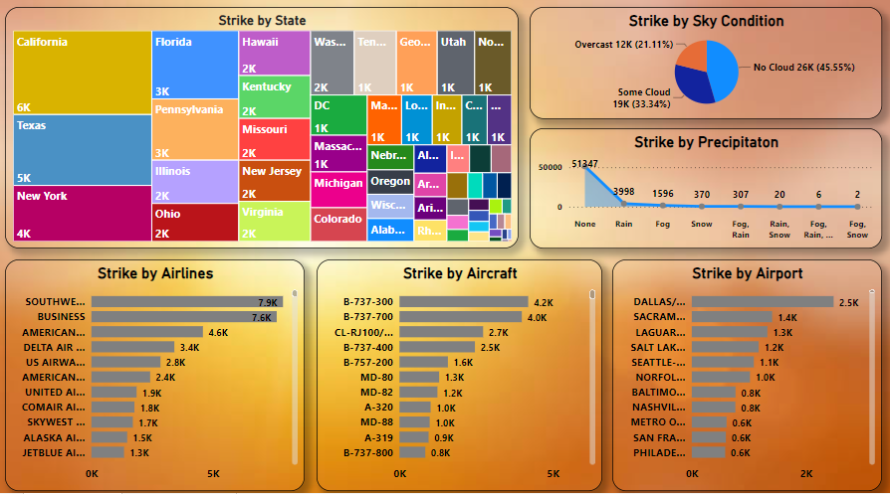
Air Service and Environment Condition

Slide 9
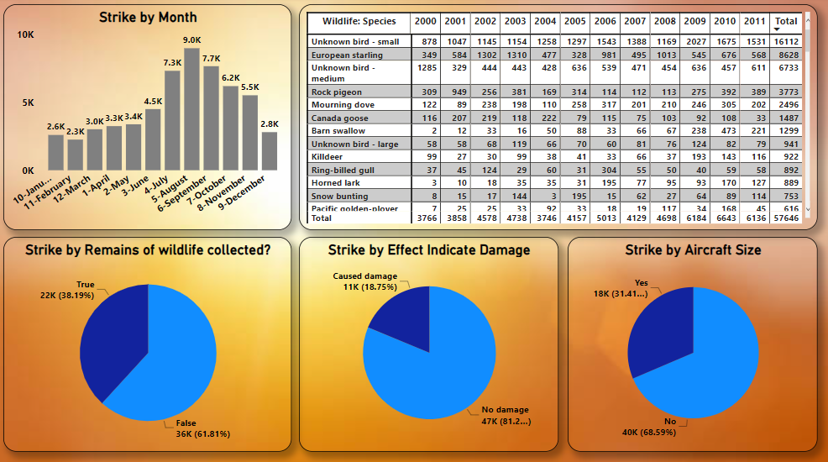
Study of Birds

Slide 10
Solution…
Modifying Habitat
Remove Seed bearing Plants to eliminate food sources
Remove Bushes and Trees that serve as attractive nesting sites
Use insecticides/ Pesticides to eliminate food sources for insect-eating birds
Modifying Bird Behavior
Use of Noise generators to disrupt Birds
Use of lasers at dawn and dusk to scare them away
Use of trained Falcons/ Dogs in the airport area to teach birds that the area has many predators
Modifying Plane Behavior
Use of radar equipment to track the density and movement of birds.
Adjust flight times to avoid busiest hours to bird activity as per the location.

Slide 11
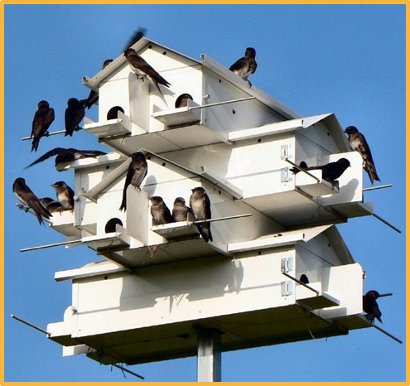
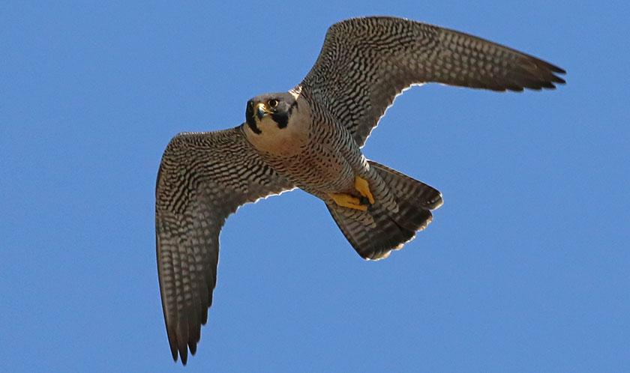
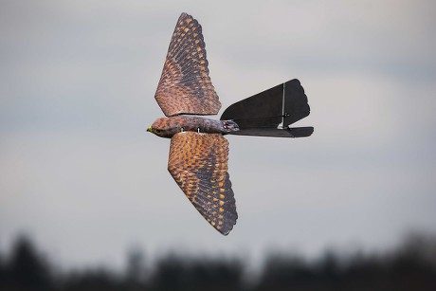
DRAWBACKS & SOLUTIONS/FUTURE SCOPE
Drawbacks:
Habitats of Birds can get affected.
Predators can sometimes themselves be a risk to the aircraft and cause confusion at the runway.
It will require a proper infrastructure, that will be a costly affair.
Restoration of electricity & Broadband might take sometime due to underground cabling
Solutions/Future Scope:
Bird Sanctuary can be set up wherein breeding box will also be a priority.
Bird houses can be built to attract birds
Bird robots in the form of predators can be used.
Proper planning through Data Analysis.
Use of robirds / drones/laser/radar equipment.
Which one is real and which one a robird ?

Slide 12
THANK YOU

